Slide 1
BE PROUD!
BE RESPONSIBLE!
2016
Posters

Slide 2
KEY WORDS
HIV:
Human Immunodeficiency Virus
AIDS:
Acquired Immunodeficiency Syndrome
Immune System
HIV Test
Latex Condoms
Window Period
Treatment

Slide 3
HIV/AIDS REVIEW
How do people get HIV? (3 ways)
What common body fluids can transmit HIV?
How is HIV not transmitted?
Who is at risk?
How can you prevent HIV?
How can you reduce the risk of HIV?

Slide 4
AGREE

Slide 5
DISAGREE

Slide 6
RISK CONTINUUM
SOME RISK
YELLOW LIGHT
(PROCEED WITH CAUTION)

Slide 7
RISK CONTINUUM
HIGH RISK
RED LIGHT
(UNSAFE)

Slide 8
RISK CONTINUUM
NO RISK
GREEN LIGHT
(SAFE)

Slide 9
STEPS FOR USING A CONDOM
Check the expiration date and make sure the condoms are latex or polyurethane/polyisoprene.
Open the package carefully to avoid tearing.
Make sure condom is on the proper side to roll down correctly.
Pinch the tip of the condom to create space (1/2 inch) for semen.
Squeeze a few drops of water-based lubricant inside the tip.
Continuing to squeeze the tip, roll the condom down to the base of the penis.
Check during intercourse to make sure the condom isn’t slipping.
Immediately after ejaculation, hold the condom firmly at the base of the penis and pull the penis out before it gets soft.
Roll off the condom away from your partner. Wrap in tissue and throw it away. Do not re-use.

Slide 10
SWAT
S = Say “NO”
REFUSE THE UNSAFE BEHAVIOR.
W = Explain why
OFFER A GOOD EXPLANATION AS TO WHY YOU WANT TO BE SAFE. EXPLAINING WHY HELPS YOUR PARTNER HEAR AND UNDERSTAND YOUR REAL CONCERNS AND PREVENTS NEGATIVE REACTIONS.
A = Provide alternatives
PROVIDE SAFE ALTERNATIVES TO SHOW THAT YOU STILL WANT TO BE INTIMATE AND HAVE A RELATIONSHIP WITH THIS PERSON, AS LONG AS IT CAN BE SAFE.
T = Talk it out
TALK OPENLY ABOUT EACH OTHER’S FEELINGS TO HELP THE RELATIONSHIP GROW AND EASE ANY TENSION.

Slide 11
NEGOTIATION AND REFUSAL SKILLS – CHART 1A
HOW TO SAY “NO” EFFECTIVELY
CHARACTERISTICS
Use and repeat the word “no” often.
Send a strong nonverbal “no” with your body language, e.g., use hand and body gestures to emphasize the point.
Project a strong, serious tone of voice.
Look directly at the person’s face and eyes.
Stand straight and tall.
Use a serious facial expression.
Don’t send mixed signals.
Making Proud Choices! Curriculum

Slide 12
NEGOTIATION AND REFUSAL SKILLS – CHART 1B
EXAMPLES OF A STRONG “NO”
EXAMPLES
No! I’m not ready to have sex yet!
No! I won’t have sex without a condom!
No! I don’t want to touch you there!
No! Stop touching me like that!
No! Stop trying to unbutton my pants!
No! I’m not going to have sex with you!
No! I really mean ‘NO’!
No! I want to protect myself. We have to use a condom.

Slide 13
NEGOTIATION AND REFUSAL SKILLS – CHART 2
EXPLAIN WHY
Give clear reasons to support your choice.
EXAMPLES
I want to protect myself with a condom every time I have sex.
No, I won’t risk my future goals by having unprotected sex.
Condoms help prevent unplanned pregnancy, and STDs or HIV infection.
I am not ready to be a parent yet.

Slide 14
NEGOTIATION AND REFUSAL SKILLS – CHART 3
PROVIDE ALTERNATIVES
Suggest another action.
EXAMPLES
Let’s go buy some condoms right now.
Let’s get out of the bedroom. It makes me feel uncomfortable.
If you’re willing to use a condom, then we can have sex.
Let’s do something else that will feel good for both of us, since we don’t have a condom.
Let’s go get something to eat.
Let’s go see a movie.

Slide 15
NEGOTIATION AND REFUSAL SKILLS – CHART 4
TALK IT OUT
Discuss your feelings.
EXAMPLES
I feel like you don’t really care about me when you pressure me like this.
I’m not ready to have a baby. I would feel better if we use a condom.
I’m glad you agreed to use condoms. I feel like you really care about me.
You really turn me on when you touch me, but I won’t have sexual intercourse without a condom.
If you can’t respect my feelings, then I’m prepared to end this relationship.
Our future goals and dreams are more important than a moment of unsafe pleasure, so I’m glad we decided to use condoms.

Slide 16
OBSERVER CHECKLIST
Pay attention to each skill you see demonstrated in the role-play.
 | Skills | Present?
S | Said “NO”
 | Refused to engage in unsafe behavior | Y/N
 | Repeated refusal | Y/N
 | Body language said “NO” | Y/N
W | Explained why
 | Gave clear reasons | Y/N
A | Provided alternatives
 | Gave reasons why | Y/N
T | Talked it out
 | Discussed feelings and used language that protected the relationship | Y/N
 | Seemed prepared to leave a potentially unsafe situation. | Y/N

Slide 17
ROLE-PLAYING GUIDELINES
Read your role carefully and think about how that person would really behave.
Do your best to stay in character through the whole role-play.
Don’t let comments and laughter distract you.
Really try to feel and act like the person you are playing.
Try things that you might not do, just to see how it feels.
Use SWAT:
  Say NO. Repeat it. Use strong body language.
  Explain why you don’t want to engage in unsafe behavior.
  Provide alternatives.
  Talk it out.

Slide 18
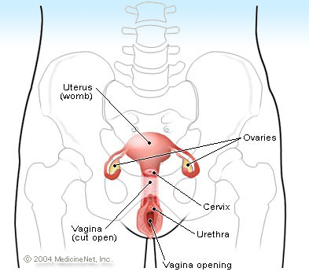
UTERUS
Fallopian tubes
Fallopian tubes

Slide 19
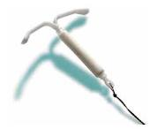
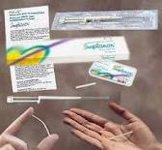
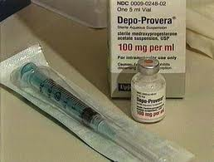

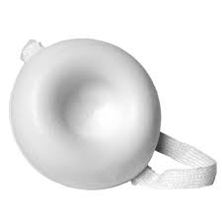

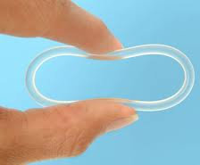
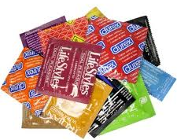
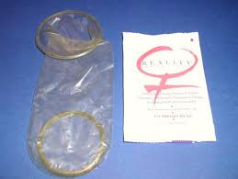
CONTRACEPTIVES
IUD
(PARAGUARD AND MIRENA)
IMPLANON
DEPO-PROVERA
(THE SHOT)
BIRTH CONTROL PILLS
BIRTH CONTROL
PATCH AND RING
CONTRACEPTIVE SPONGES
MALE CONDOMS
FEMALE CONDOMS

