Slide 1
Creating Inclusive Program Environments for Youth with Different Abilities
Jutta Dotterweich
ACT for Youth
Cornell University

Slide 2
Training Overview
Introductions& Objectives
Section 1: Including youth with different abilities
Section 2: General Strategies to Create Inclusive Program Environments
Section 3: Promoting a Sense of Belonging
Section 4: Integrating Mindfulness and De-Stressing Activities
Section 5: Modeling and Teaching Empathy
Section 6: Addressing Challenging Behavior
Section 7: Disability Legislation, Accommodations and Working with Community Partners

Slide 3

1. Including Youth with Different Abilities

Slide 4

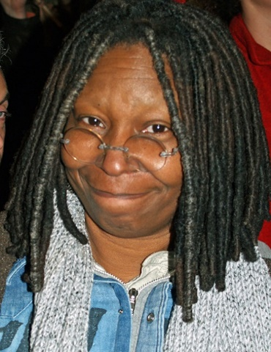


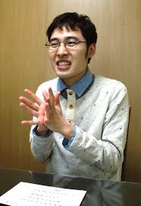
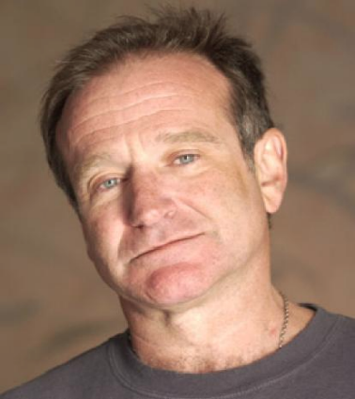

Notes:
Tom Cruise – diagnosed at age 7 with dyslexia. Described himself as functionally illiterate, could barely read in high school
Salma Hayek – Dyslexia (diagnosed during teen years in Mexico)
Robin Williams – ADHD
Whoopi Goldberg – dyslexia
Simone Biles - ADHD
Michael Phelps – ADHD
Naoki Higashida - autism

Slide 5
“Hidden” or Undisclosed Disabilities
Learning Disabilities
Autism Spectrum Disorder
ADHD
Trauma

Slide 6
Learning Disabilities
Youth with learning disabilities see, hear, and understand things differently. Common types of learning disabilities:
Dyslexia (reading)
Dyscalculia (math)
Dysgraphia (writing)
Dyspraxia (Fine motor skills)
Dysphasia (spoken language)
Notes:
Dyslexia – one in 5 estimated, 80% of learning disabilities
Kids with dyslexia have a hard time decoding new words, or breaking them down into manageable chunks they can then sound out. This causes difficulty with reading, writing and spelling.

Slide 7
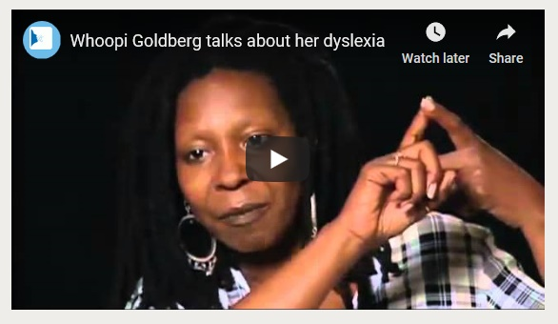
What does it feel like?
https://www.dyslexia-reading-well.com/whoopi-goldberg.html

Slide 8
ADHD
Challenges
Get distracted easily and forget things
Switch too quickly from one activity to next
Have trouble with directions
Have trouble finishing tasks
Lose things
Fidget and run around a lot
Touch and play with everything they see
Blurt out inappropriate comments
Have trouble controlling their emotions
Impulsivity
Inconsistent Attention
Hyperactivity

Slide 9
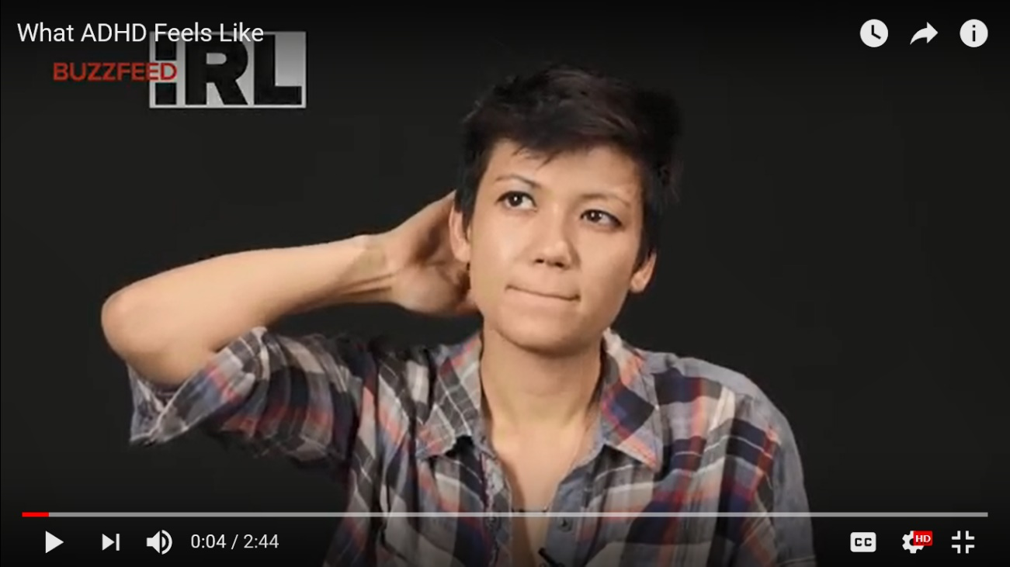
What does it feel like?
https://www.youtube.com/watch?v=NL483G4xKu0

Slide 10
Autism Spectrum Disorder
Impaired social interaction
Difficulty in communication
Tendency to have restricted range of interest
Notes:
1 in 68 children
4.5 boys to 1 girl
CDC Tracking System

Slide 11
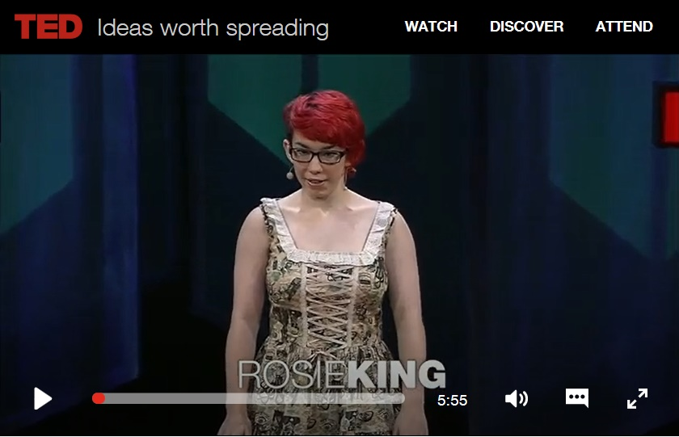
What does it feel like?
https://www.ted.com/talks/rosie_king_how_autism_freed_me_to_be_myself#t-2281

Slide 12
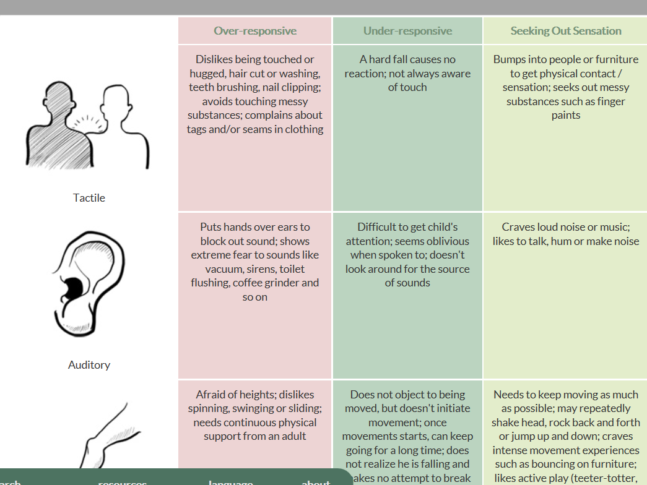
http://www.interactingwithautism.com/section/understanding/sensory/1
Source: Interacting with Autism http://www.interactingwithautism.com/

Slide 13
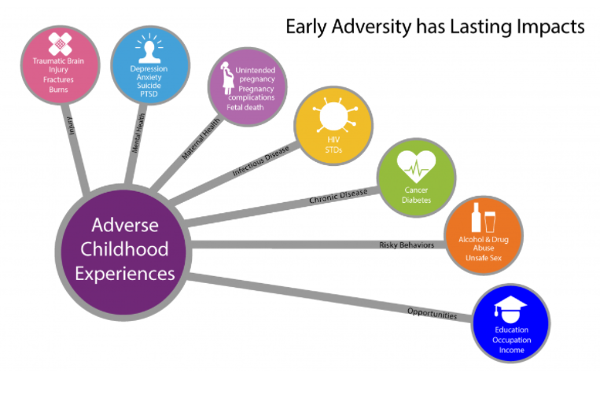
Living with Trauma
About the CDC-Kaiser ACE Study |Violence Prevention|Injury Center|CDC
Notes:
Stress signals involve feelings, thoughts, behaviors and physical reactions
What are yours?
Identify triggers for stress

Slide 14

How childhood trauma affects health across a lifetime
https://www.ted.com/talks/nadine_burke_harris_how_childhood_trauma_affects_health_across_a_lifetime

Slide 15
Defining Trauma
Trauma results from an event, series of events, or set of circumstances that is experienced by an individual as physically or emotionally harmful or life threatening and that has lasting adverse effects on the individual’s functioning and mental, physical, social, emotional or spiritual well-being.
SAMHSA 2014
Notes:
Ask what type of events

Slide 16
Re-Traumatization
A situation, attitude, interaction, or environment that replicates the events or dynamics of the original trauma and triggers the overwhelming feelings and reactions associated with them
Notes:
Sample Triggers:
- Touch, sounds, gestures, light, opening a door without knocking

Slide 17
Effects of Trauma
Behavioral Effects | Cognitive Effects | Social Effects
- Risk taking - Acting out - Rule breaking | Attention Memory Executive functions Verbal abilities Skills development Language Group work Problem solve Transition | Impulsivity Aggression Deviance Withdrawal Challenged relationships
Notes:
What do they internalize?
People will hurt me
I’m helpless to prevent bad things from happening
I’m defective
I don’t matter
I’m helpless
I’m worthless
I can’t trust anyone
You will hurt me

Slide 18
Trauma- Informed Approach
Guiding Principles
Safety
Trustworthiness
Choice
Consider Culture, History, Gender
Collaboration
Empowerment
SAMHSA 2014
Notes:
Key Strategies
Safe & inclusive environment
Transparency/Predictability
Choice/Empowerment
Participation/Collaboration

Slide 19

Thinking about your youth programs what challenges could you expect?
https://www.template.net/design-templates/inspirational/sad-emoji/

Slide 20
Potential Challenges
Restlessness/Impulsivity
Aggression/Agitation
Withdrawal
Inattention
Immaturity

Slide 21

What is Our Role?
We are positive role models!
Youth workers are “individuals who work with or on behalf of youth to facilitate their personal, social and education development and enable them to gain a voice, influence and place in society as they make the transition from dependence to independence”
(Stone, Garza & Borden, 2004)

Slide 22

2. General Strategies to Create Inclusive Program Environments
https://www.adl.org/education/resources/tools-and-strategies/safe-and-inclusive-schools-for-all

Slide 23
General Strategies
UDL Guidelines
Group agreements
Power Cards
Transparency and predictability
Establishing a ‘Comfort Corner’

Slide 24
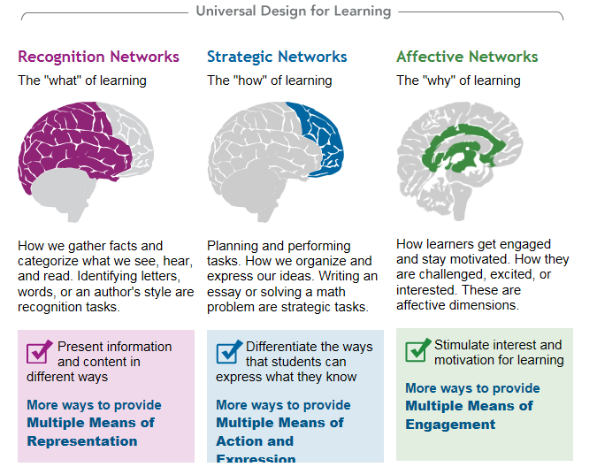
http://www.udlcenter.org/aboutudl/whatisudl

Slide 25
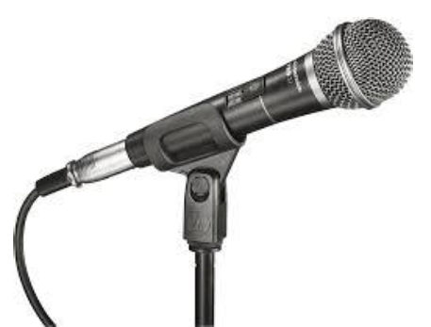
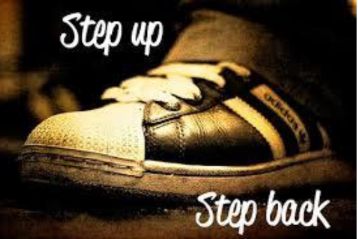


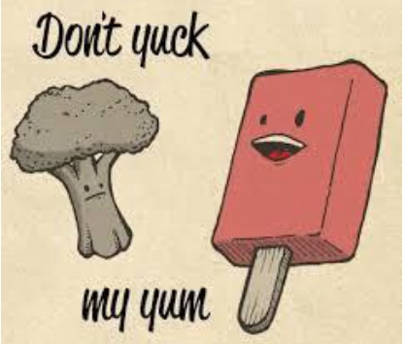
Group
Agreements

Slide 26
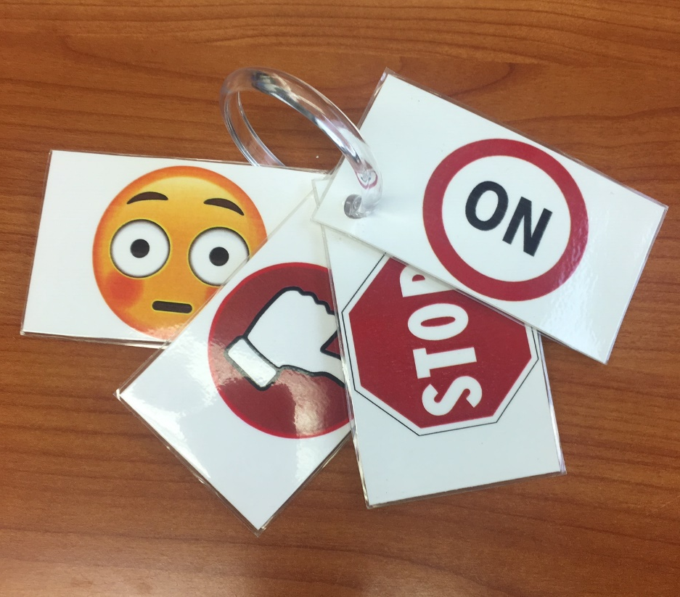
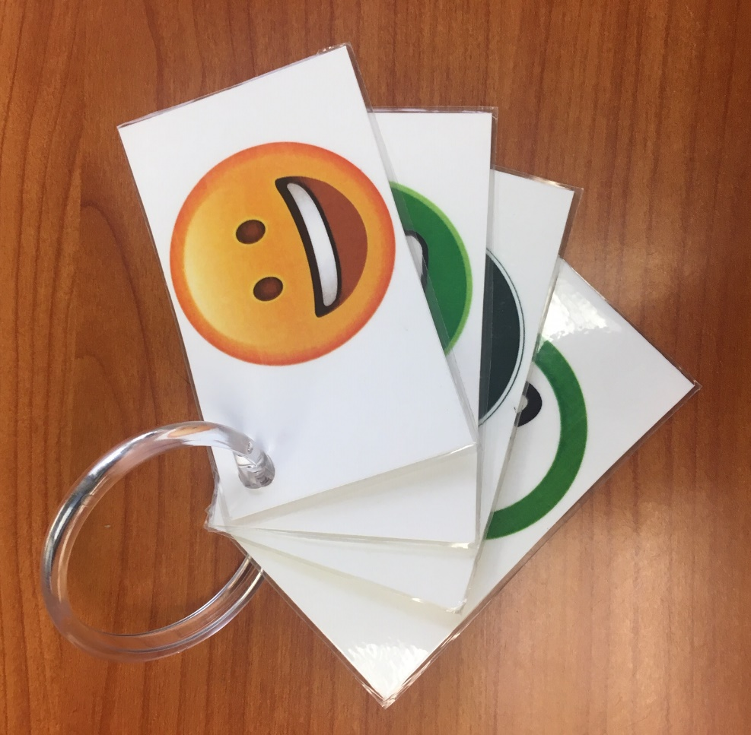
Power Cards

Slide 27





Transparent & Predictable
Schedules & Routines
Ease transitions
Room set up
Calm Zone

Slide 28

What is a Comfort Corner?

Slide 29
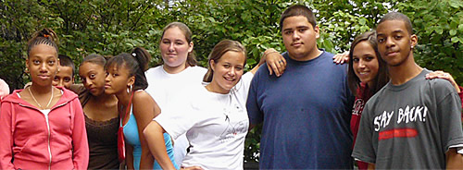
3. Promoting a Sense of Belonging

Slide 30

Belonging
Feeling like an accepted, valued, and legitimate group member

Slide 31
Promoting Belonging
Promote belonging by changing the environment
- Emphasize similarities
- Practice inclusivity, participation, and mutual respect
- Create formal and informal ways for youth and adults to learn about each other’s interests, aspirations and good things going on in their lives
- Create a welcoming environment (incl. physical environment)
Notes:
Last point – objects/pictures reflecting people’s culture/social groups

Slide 32
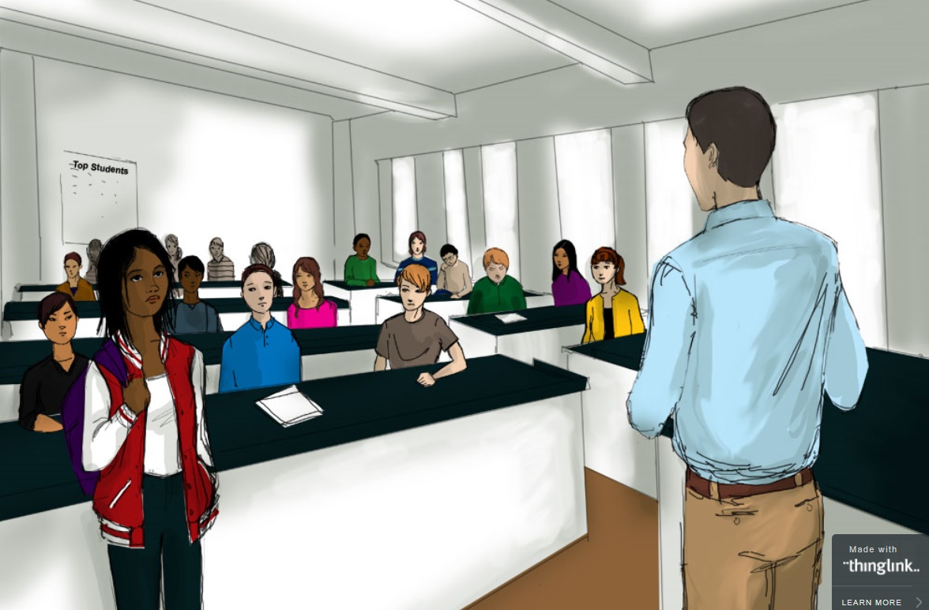
https://www.edweek.org/ew/section/multimedia/illustration-microaggressions-in-the-classroom.html
Beware of Microaggressions

Slide 33
Microaffirmations
Harvard’s Research: Accentuate the Positive
Nodding and making eye contact with youth while they’re talking
Making sure to call on all youth equally
Referring to every young person by their name
Using inclusive language — for instance, talk about “families” instead of “parents”
Openly giving praise for a wide-range of actions, from answering a question right to sitting still during a lesson
Staying enthusiastic when interacting with youth
https://www.gse.harvard.edu/news/uk/16/12/accentuate-positive

Slide 34
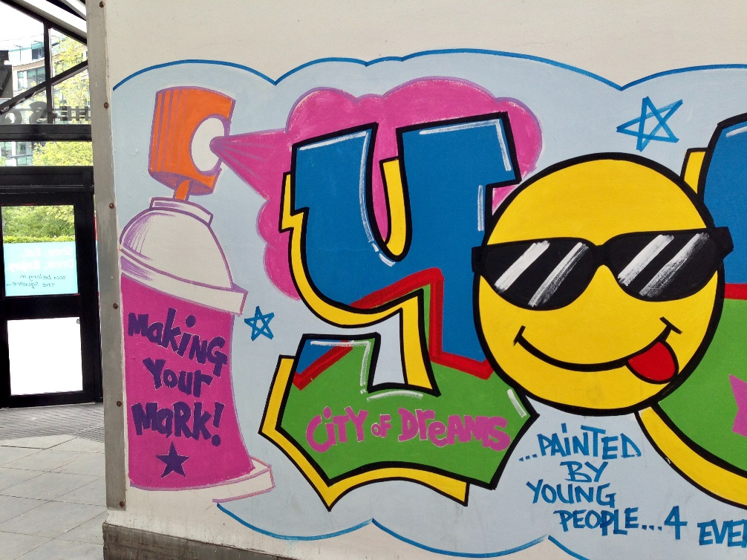
Build on Strengths
Identify interests, passions, talents, and aspirations

Slide 35

4. Integrating Mindfulness and De-stressing Activities
https://www.uhs.umich.edu/mindfulness
Notes:
Do the breathing, then the jar

Slide 36
Mindfulness
“paying attention on purpose in the present moment and non-judgmentally”
                Jon Kabat-Zinn. 2011
“Mindfulness is paying attention, here and now, with kindness and curiosity, so that we can choose our behavior”
Amy Saltzman. 2014
Notes:
Heightened awareness of internal and external experiences (thoughts, smells, feelings, body and sights)
Nonjudgmental observation of these experiences
Compassion toward self
Development of openness and curiosity toward internal and external experiences
Ability to return to the present as thoughts arise

Slide 37
Mindfulness Impacts
Stress reduction
Attention
Emotional control
Positive self-concept
Positive Interactions

Slide 38
Mindfulness Tips
Practice mindfulness yourself
- Integrate a mindfulness activity into your own day
- Use it to get ready for a program session
Build it into your youth program
- Make an activity part of the program routine
- Encourage youth to practice on their own (at home, etc.)
To motivate – watch LeBron https://www.youtube.com/watch?v=SCR7OfRuQd4
Notes:
Use before going into a group session – reminding yourself of a difficult youth

Slide 39

Handling Stress/ Promoting Self-Regulation

Slide 40
Helping Youth Cope with Stress
Triggers
Things that make me upset are…
Feelings
What does it make me feel like?
Coping
Things I can do that help me feel better
Sample tip sheet: http://www.learnalberta.ca/content/insp/html/student/amiangry.pdf

Slide 41
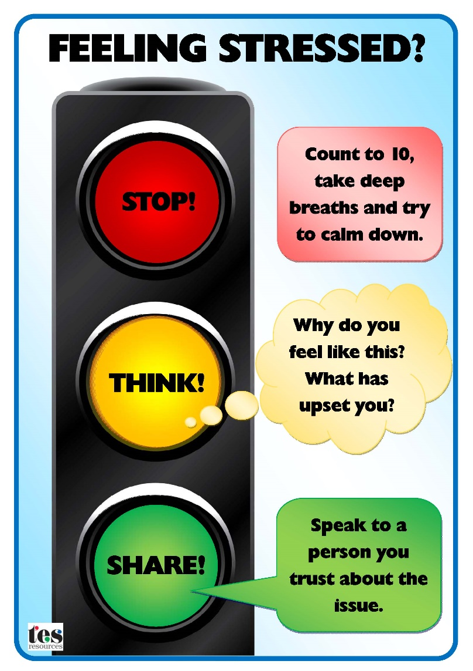
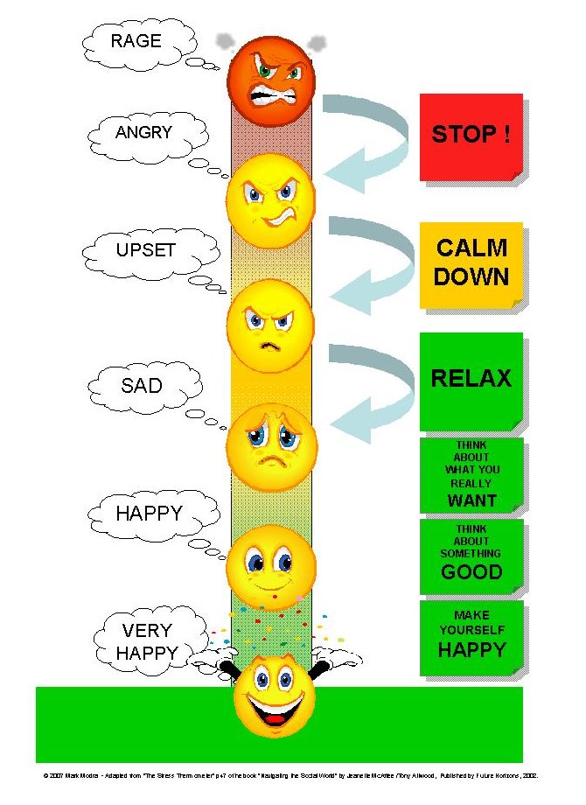

Slide 42

Integrate Stress Reducing Activities
Relaxation exercises
Physical activity
Walks/activities in nature
Creative/arts activities

Slide 43

5. Modeling and Teaching Empathy

Slide 44
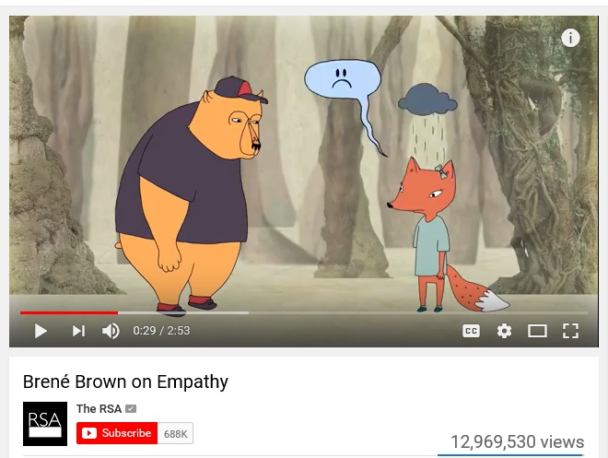
Empathy vs
Sympathy
https://www.youtube.com/watch?v=1Evwgu369Jw

Slide 45
Empathy – A Definition
Ability to sense other people’s emotions, coupled with the ability to imagine what somebody else might be thinking or feeling.
Affective empathy refers to the sensations and feelings we might get in response to other people’s emotions (e.g., mirroring)
Cognitive empathy refers to our ability to identify and understand other people’s emotions (perspective taking)

Slide 46
Modeling and Practicing Empathy
Active Listening
Practice Kindness
Perspective Taking

Slide 47

Non-Verbal Techniques
Silence
Eye Contact
Facial expression
Posture (e.g., leaning forward)
Minimal encouragement
(“uh-huh,” go on, etc.)
Tone of voice

Slide 48

Active Listening
Listening for meaning
Attentive to speaker
Reflecting facts and feelings
Interpreting meaning, feelings
Withholding opinions and judgment

Slide 49
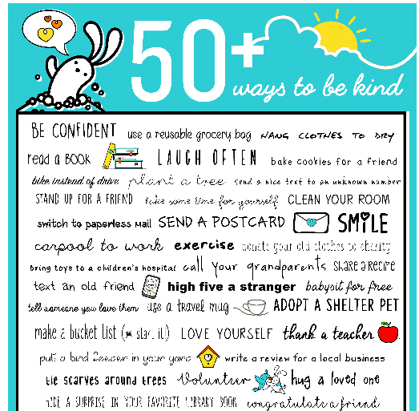
Poster
https://downloads.randomactsofkindness.org/RAK_kindness_poster.jpg
Source: https://www.randomactsofkindness.org/

Slide 50
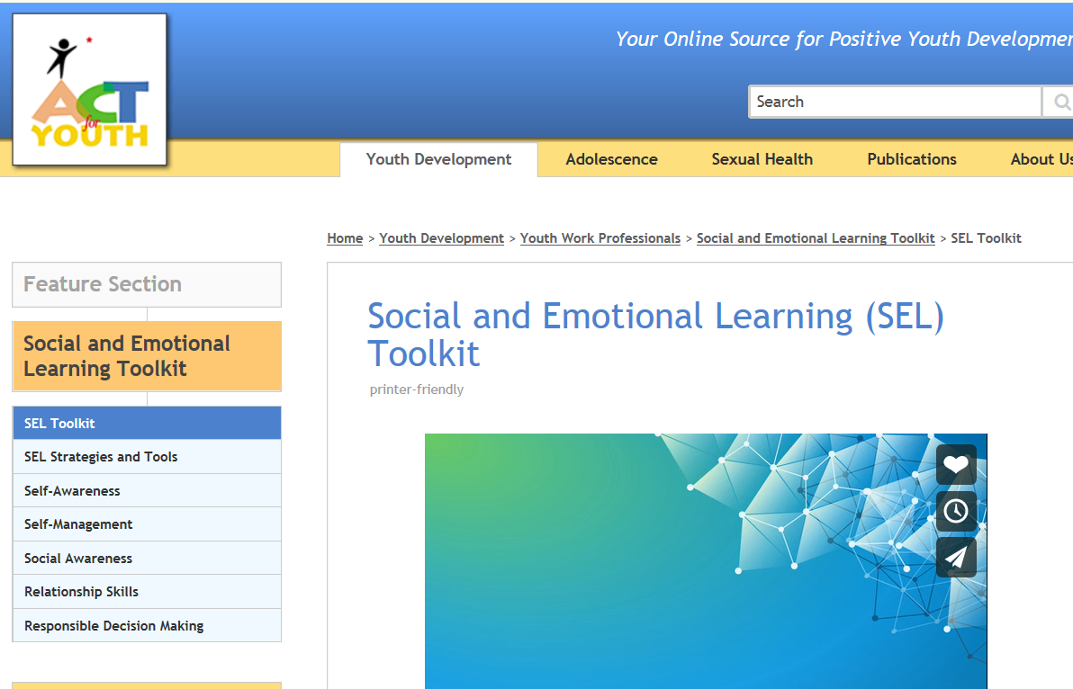
http://www.actforyouth.net/youth_development/professionals/sel/

Slide 51

6. Addressing Challenging Behavior
https://sites.google.com/site/bcbaservice/home/aba-therapy/challenging-behaviors

Slide 52

Self Reflection
Activity

Slide 53
A New Behavior Perspective
Misbehavior is a symptom of an underlying cause
Behavior is communication
Behavior has a function
Behavior occurs in patterns
Behavior can be changed
Only behavior an adult can control is her own

Slide 54
Behavior Analysis
Look for behavior patterns
Antecedents – Behavior – Consequences
Identify behavior goals
Attention, escape, etc.
Teach underdeveloped skills
Self-regulation, social skills, executive functions (self-control), flexible thinking

Slide 55
Environmental Scan & De-Escalation
Assess and Address Environment
Lighting
Noise level
Time of day (arrival, after breaks)
Community settings – crowds, noise, activity level
Read Early Warning Signs
Tense body language, pacing, louder voice, sudden behavior change → check-in with youth

Slide 56
Keep in Mind…When Stressed
Meaning =
Facial Expression
+
Tone of Voice
+
Words
55%
38%
7%

Slide 57
Behavior Management Techniques
Proximity
Prompts
Hurdle help
Time away
Redirection
Directive statements
Caring gesture

Slide 58

7. Disability Legislation, Accommodations and Working with Community Partners

Slide 59
Defining Disability
Disabilities affect people’s daily functioning, work, social relationships and participation in public life.
Disabilities can be
Physical
Sensory
Developmental
Intellectual
Learning
Mental health condition
Health condition

Slide 60
Important Disability Legislation
Individuals with Disabilities in Education Act (IDEA)
Americans with Disabilities Act (ADA)
Protect
Discrimination
Abuse
Provide
Additional services
Accommodations
Notes:
The “Individuals with Disabilities Education Act” (known as IDEA) is important legislation for children and youth.
The major disability legislation for adults (beyond high school) is the “Americans with Disabilities Act” (ADA).
Disability legislation has two main functions: to protect from discrimination and abuse, and to provide additional services or accommodations that will remove or reduce barriers.

Slide 61
Accommodations
  An accommodation is essentially any strategy that overcomes or lessens the effect of a specific barrier. A barrier is an obstacle that may exist in school, at the workplace, in the community, or in one’s own home.
  Accommodations
  Changes to facilities
  Special services
  Creative thinking and problem solving
Notes:
Before discussing each law, it’s important to understand “accommodations.” Accommodations play a major role in helping individuals with disabilities access and utilize services and opportunities.
An accommodation is essentially any strategy that overcomes or lessens the effect of a specific barrier. A barrier is an obstacle that may exist in school, at the workplace, in the community, or in one’s own home. It might be that the disability creates the barrier, or it might be that due to the disability the obstacle is difficult to manage without support.
There are three major types of accommodations:
Changes to facilities and equipment, such as ramps, or traffic lights equipped with audio signals.
Provision of special services, such as videos that explain application forms, or having someone read the instructions and questions on a form.
- Creative thinking and problem solving, such as flexible work schedules or telecommuting (working at home).

Slide 62
Individuals with Disabilities in Education Act (IDEA)(IDEA)
Unit 4
IDEA covers ages: Birth - 21
Thirteen Categories:
Autism, Deaf-blindness, Deafness, Emotional Disturbance, Hearing impairment, Mental retardation, Multiple disabilities, Orthopedic impairment, Other health impairment, Specific learning disability, Traumatic brain injury, Speech or language impairment, Visual impairment
Notes:
Let’s turn to the Individuals with Disabilities Education Act, or IDEA This law was initially developed in 1975, but has been updated several times. It has two parts: one for early childhood (from birth through age 2), and one for children and youth age 3 through 21.
IDEA recognizes 13 categories of disability:
Autism, Deaf-blindness, Deafness, Emotional Disturbance, Hearing impairment, Mental retardation, Multiple disabilities, Orthopedic impairment, Other health impairment, Specific learning disability, Traumatic brain injury, Speech or language impairment, Visual impairment including blindness

Slide 63
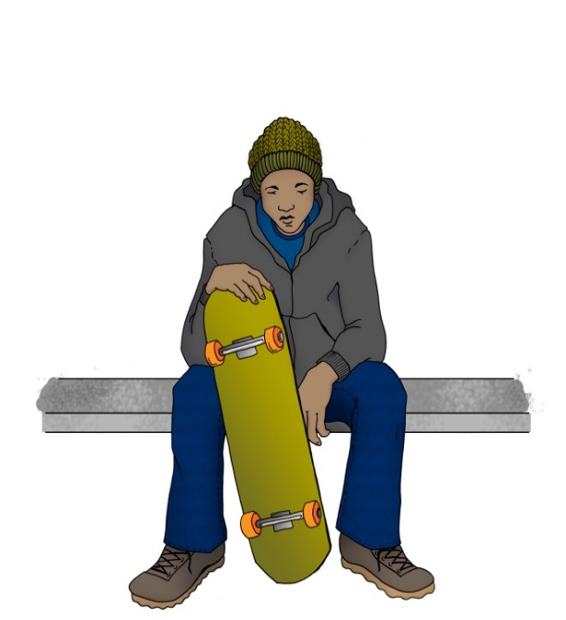
IDEA Impact on Education
Free public education
Quality instruction
Testing to establish needs and services
Individual education plan (IEP)
Specialty support or accommodations
Accommodations can include
Verbal instructions
Visuals
Additional test time
Notes:
This law mandates that states provide free public education to all children and youth with disabilities. There are several requirements under IDEA:
Quality instruction and qualified teachers. “Quality” includes placing students in the least restrictive setting.
Systematic testing to establish needs and services.
Individual education plan (known as IEP), which includes a statement about the young person’s academic achievements and needs, annual measurable goals, and alternative assessments or tests.
Specialty support or accommodations.
For example, if a student has a reading disability that makes it difficult for him to understand written language, he could receive additional support such as verbal instructions, visuals, and extra time for taking tests.

Slide 64
Americans with Disabilities Act (ADA)
A person qualifies as having a disability if they meet one of the following:
  A physical or mental impairment that substantially limits one or more major life activities
  A record of such impairment
  A perception by others as having an impairment
Notes:
Now we’ll consider the legislation that protects people with disabilities from discrimination. This is the Americans with Disabilities Act or ADA, a comprehensive civil rights law.
The ADA defines a person with a disability as an individual who has a physical or mental impairment that substantially limits one or more major life activity. This includes people who have a record of such an impairment, even if they do not currently have a disability. It also includes individuals who do not have a disability but are perceived to have one. ADA also protects people associated with an individual who has a disability from discrimination. For example, it is not legal to discriminate against a person who works in a mental health facility.

Slide 65
Accommodations
Accommodations are provided only when a person discloses his or her disability and requests accommodations.
Disclosure is not mandatory, but needed when asking for accommodations.
Decision to disclose belongs solely to the person with a disability
They are not considered reasonable if they represent “undue burden” or fundamentally alter the program.
Notes:
Disadvantages of disclosure
-exclusion, being treated
Ask if they could think of reasons why people do not want to disclose

Slide 66
COMMUNITY NEEDS MAP
Dilapidated
Housing
Unemployment
Gangs
Single Parent
Families
Teen Pregnancy
Illiteracy
Child
Abuse
Mental
Disability
Crime
Alcohol &
Drug
Abuse
Domestic
Abuse
Juvenile Delinquency
Poverty
Homelessness
Suicide & Depression

Slide 67
NEEDS | ASSETS
Focuses on deficiencies | Focuses on effectiveness
Results in fragmentation of responses to local needs | Builds interdependencies
Makes people consumer of services; builds dependence | Identifies ways that people can give their talents
Residents have little voices in deciding how to address local concerns | Seeks to empower people

Slide 68
COMMUNITY ASSETS MAP
Local Institutions
GOVERNMENT
HOSPITALS
Citizens’ Associations
BUSINESS
CHURCHES
BLOCK CLUBS
SCHOOLS
Gifts of
Individuals
INCOME
SKILLS
ELDERLY
DIFFERENTLY
ABLED PEOPLE
YOUTH
PARKS
CULTURAL CLUBS
COLLEGES
HUMAN SERVICE AGENCIES
LIBRARIES

Slide 69
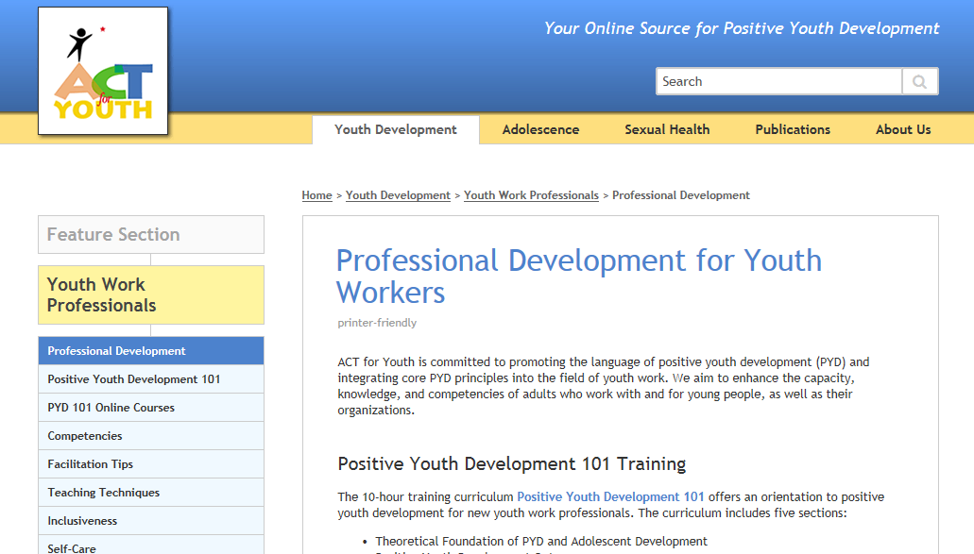
Resources
http://www.actforyouth.net/youth_development/professionals/
Notes:
Trauma Informed Community Initiative of WNY

Slide 70
Wrapping Up
I feel…
I learned…
I never knew…
I now understand…
I wish…
I’m glad that…
I appreciate

