Slide 1
How is COVID-19 Impacting the Emotional Well-being of Adolescents?
PYD Network Jutta Dotterweich, ACT for Youth December 10, 2020

Slide 2
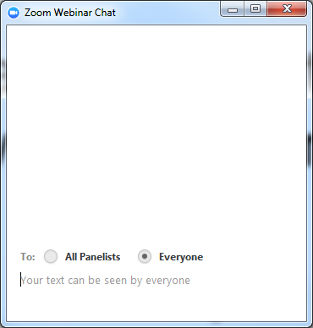
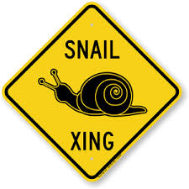
Housekeeping
Experiencing delays?
Try closing out the other
programs running on your
computer
Questions?
Use chat function. Post to Everyone.

Slide 3
Agenda
PYD Network History
COVID-19 challenges adolescent development
What do we know so far?
What do young people report?
How do we support young people?
Resources

Slide 4
PYD Network: History & Background
NYS AYD Partnership:
1998 - 2012
New PYD Curriculum 2015
New PYD Online Courses
2016-17
Creating Inclusive Program Environments…Manual 2019
http://www.actforyouth.net/youth_development/professionals/

Slide 5
A Time like no other
Economic hardships
Trauma
Loss of loved ones
Loss of school community
No prom
Social Isolation
Uncertainty
No sports
Social media and gaming 24/7
Depression
New responsibilities in family
No graduation celebration
Boredom
Daily routines disturbed

Slide 6
adolescent developmental Tasks - Disrupted?
Develop/apply abstract
thinking skills
Develop/apply more
complex perspective
taking
Adjust to maturing
bodies and feelings
Develop/apply new coping skills
Renegotiate
relationship with
adults
Sense of purpose, agency
& autonomy
Take on increasingly
mature roles and
responsibilities
Identify moral
standards, values, and beliefs
Develop identity
(different aspects)
Form friendships that
are close and supportive
Understand/express more
complex emotional experiences

Slide 7
Adolescent Brain Development
Period of growth
Brain centers still maturing
Imbalance: Emotional brain in the driver’s seat

Slide 8
What do we expect? How do young people respond to this?

Slide 9
Child & Adolescent mental health
Mental health in childhood means reaching developmental and emotional milestones, and learning healthy social skills and how to cope when there are problems.
Mental disorders among children are described as serious changes in the way children typically learn, behave, or handle their emotions, which cause distress and problems getting through the day.
https://www.cdc.gov/childrensmentalhealth/basics.html

Slide 10
Increase in Mental Health Issues
Under “regular” circumstances
13-20% of children under 18 experience a mental health disorder in a given year
Only about 50% of these children with mental health disorders receive specialized mental health care
Prediction: Impact of COVID-19
- Increase of disorders to 25-30% of all young people
Gil Noam, PEAR Institute, Associate Professor of Psychiatry, Harvard Medical School
Webinar: Mental Health and Youth Development: Priorities for the Summer and Beyond

Slide 11
CDC data June 2020
Higher rates for young adults, racial/ethnic minorities, essential workers and unpaid adult caregivers
3 – 4 times higher than comparable data from 2019
Mental Health, Substance Use, and Suicidal Ideation During the COVID-19 Pandemic — United States, June 24–30, 2020 | MMWR (cdc.gov)
Notes:
3-4 times higher than numbers in 2019
Around 5900 responded out of 9.800 eligible for the online survey

Slide 12
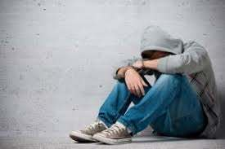
Recent Studies: Children and Adolescents
Impact of COVID-19:
- Increased stress
- Increase in anxiety
- Increase in depression
- Smart phone addiction
CDC
- Increase in mental health
related ED visits

Slide 13
What do Adolescents say?
Teen Mental Health, Harris Poll (National 4-H) June 2020
Online survey, 1,516 participants (ages 13-19), across US
Are the Kids Alright? California Partners Project, Child Mind Institute & Material+, November 2020
In depth interviews and week-long diary entries (of youth and parents) documenting daily behaviors (sleep, exercise, internet use, and corresponding mood), 46 participants, living in California

Slide 14
Harris Poll (4-H Study)
PowerPoint Presentation (4-h.org)

Slide 15
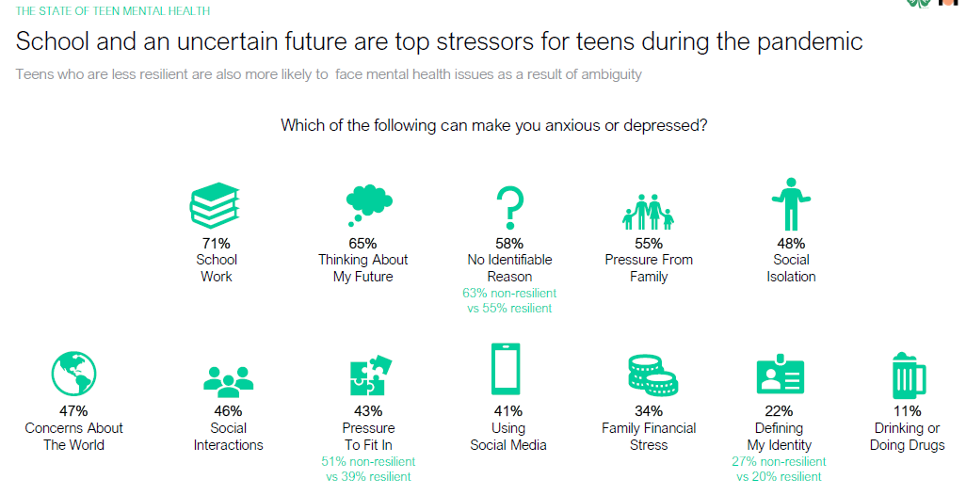

Slide 16
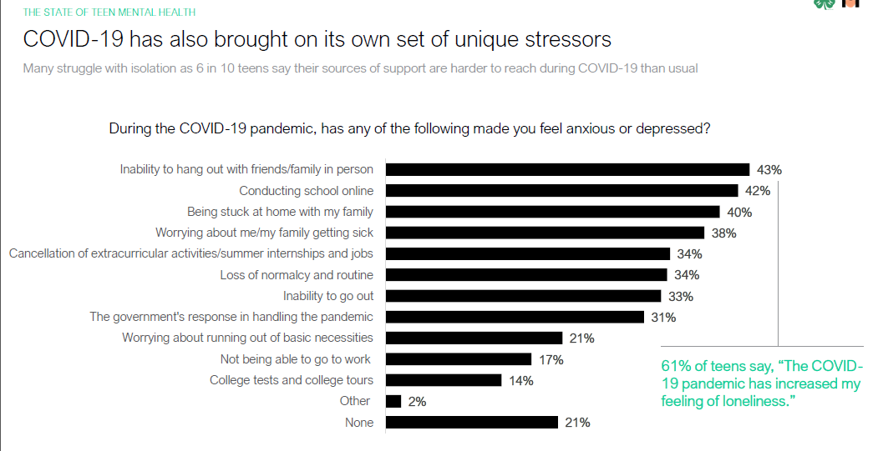

Slide 18
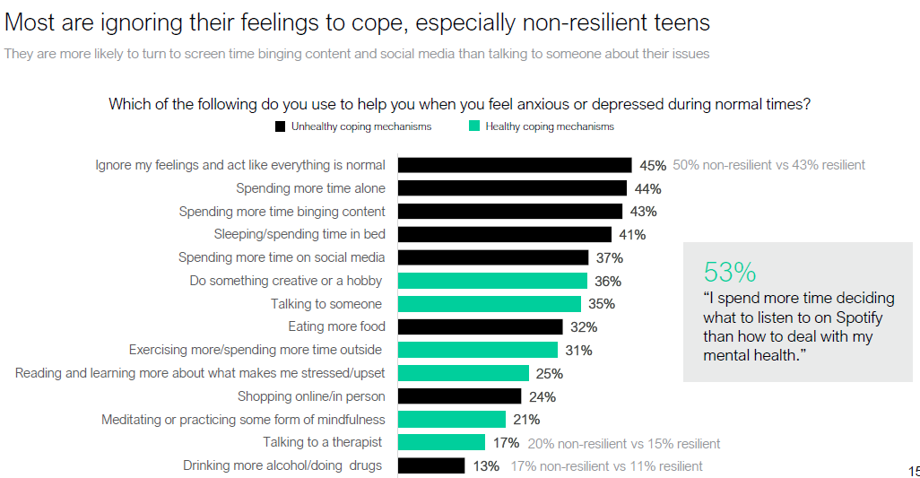

Slide 19
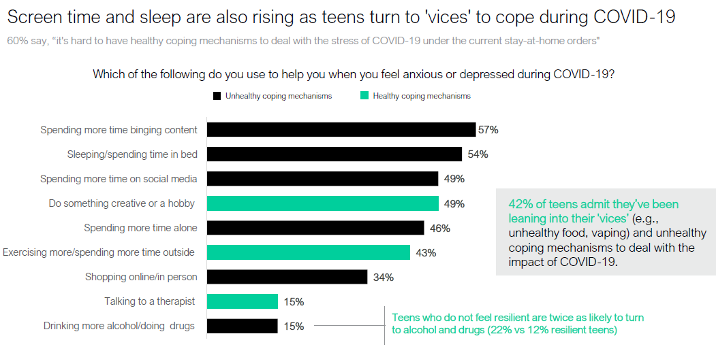

Slide 21
Any Takeaways?

Slide 22
California Partners project
Are the Kids Alright? | calpartnersproject
Includes toolkit for teens and parents

Slide 23
Key Findings
Teens are experiencing a tremendous loss due to school closure and social isolation
There is limited opportunity to do the “work of adolescence” and form their identities
Social media and gaming have become the main way to meet their social needs
The extent of tech use and its impact aren’t obvious, even to those closest to teens

Slide 25
Experiencing Loss - Stages of grief
“At first, it was this cool thing. We
aren’t going to school. I remember
the first few days I was still seeing people. I’m
not going to get the virus from these people. It
was such a far-off thing in my community.”
~Age 17, Sonoma County
“When it first started, when I
heard we were not going back, it
was pure shock. We were not able to see friends
and go certain places and travel. It ruined my
summer. With anger comes sadness.”
~Age 16, Sonoma County
“I was angry that sports and my
whole life stopped with the pandemic…
It’s our junior year in high school and that’s
one of the most important, especially
for sports. We haven’t been able to go to
tournaments. College coaches are not
traveling.” ~Age 16, Sonoma County
“But once this started to happen,
I kind of accepted that it’s kind of
just another year of school and it’s going to be
different and more difficult in some ways and
easier in others.” ~Age 15, San Francisco County

Slide 26
Social media and gaming main way to meet social needs
“TikTok is a good pass time, but it
definitely doesn’t make quarantining
better, I’d rather be with my friends.”
~Age 17, Alameda County
“TikTok is the one I spend the
most time on because it has stuff
I actually want to watch. If I don’t have anything to do, TikTok’s the obvious place to go.”
~Age 14, San Mateo County

Slide 27
Recognizing dangers of overuse
“Addicted” to technology and apps
“I could quit, but I don’t want to…”
“I know it’s bad, but everybody is doing it”

Slide 29
Parent dilemma
Parent diaries
Underreported their children’s screen time

Slide 30
Supporting teens
Acknowledge what has been taken away
Don’t blame teens for their coping mechanisms
Know the signs of depression and anxiety
Be aware of the behavior you are modelling
What to look for
Feeling very sad or withdrawn for two or three weeks
Intense worries or fears that get in the way of daily activities
Severe mood swings that cause problems in relationships
Drastic changes in behavior or personality
Severe, out-of-control behavior
Repeated use of drugs or alcohol

Slide 31
ANY takeaways?

Slide 32
Evolving Science of Learning and Development (SOLD)
Malleability
Experience dependent growth
Context
Brain Development
Cortisol and oxytocin are hormones that the body produces in response to context – cortisol in response to stress, oxytocin in response to love and trust.
Pamela Cantor et al. 2018

Slide 33
How do we support young People?
New Three R’s
o Relationships: The science tells us that relationships are the active ingredient in the learning environment, and the antidote to toxic stress.
o Routines: The brain is a predictive machine, and is calm when things are orderly, making routines and consistency vital pieces of environments that encourage brain development.
o Resilience: The key to building resilience is recognizing that we all – adults and youth alike – have strengths to build upon. Asset-based approaches allow us to help them understand and manage their emotions.

Slide 34
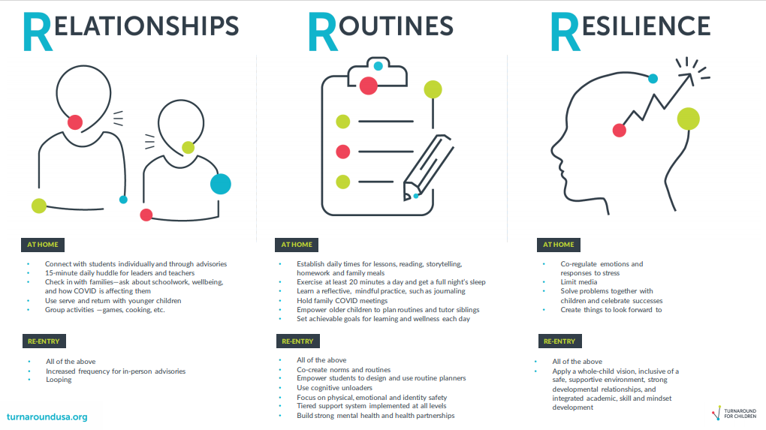
Resources For The New Three Rs: Relationships, Routines and Resilience | Turnaround for Children (turnaroundusa.org)

Slide 35
Quest

Slide 36
Resources
Turnaround for Children -
Coronavirus (COVID-19) Pandemic Resources | Turnaround for Children (turnaroundusa.org)
Stress and the Brain | Turnaround for Children (turnaroundusa.org)
CDC. Daily Life Coping/Stress and Coping - https://www.cdc.gov/coronavirus/2019-ncov/daily-life-coping/stress-coping/index.html
The Five Steps (suicide prevention) How The 5 Steps Can Help Someone Who is Suicidal - #BeThe1To
Child Mind Institute - Child Mind Institute | Transforming Children's Lives.
CASEL - Covid- 19 SEL Resources (casel.org)
ACT for Youth: SEL Toolkit - http://www.actforyouth.net/youth_development/professionals/sel/

Slide 37
References
Karen Dineen Wagner. 2020. New Findings About Children’s Mental Health During COVID-19. Psychiatric Times. https://www.psychiatrictimes.com/view/new-findings-children-mental-health-covid-19
Racine, N. et al.2020. Child and Adolescent Mental Illness during COVID-19: A Rapid Review. Psychiatry Res. 2020 Oct; 292: 113307. Published online 2020 Jul 16. doi: 10.1016/j.psychres.2020.113307
CDC. MMWR. Mental Health–Related Emergency Department Visits Among Children Aged <18 Years During the COVID-19 Pandemic — United States, January 1–October 17, 2020 (published 11.13.20) https://www.cdc.gov/mmwr/volumes/69/wr/mm6945a3.htm?s_cid=mm6945a3_w
Emma Goldberg. Nov 2020. Teens in Covid Isolation: “I felt Like I was a suffocating”. New York Times. https://www.nytimes.com/2020/11/12/health/covid-teenagers-mental-health.html
Harris Poll (National 4-H) Teen Mental Health The State of Teen Mental Health During COVID-19 in America: a 4‑H and Harris Poll Youth Mental Health Survey | The Harris Poll
Pamela Cantor et al. 2018. Malleability, plasticity, and individuality: How children learn and develop in context. Full article: Malleability, plasticity, and individuality: How children learn and develop in context1 (tandfonline.com)

