Slide 1

POSITIVE YOUTH DEVELOPMENT
101
Developed by the ACT for Youth Center for Community Action
www.actforyouth.net

Slide 2

Training Overview
Positive Youth Development
Positive Youth Outcomes
Youth Voice & Engagement
Youth Development Programming
Youth Worker Competencies

Slide 3
1. Positive Youth Development

Slide 4

What is PYD?
Child and adolescent development?
Youth programs?
A philosophy or approach?

Slide 5
Ecological Model of Development
Laws/Norms
Economics
Peer
Family
Role models
School
Youth
Faith Communities
Work
Neighborhood
Media/Internet

Slide 6
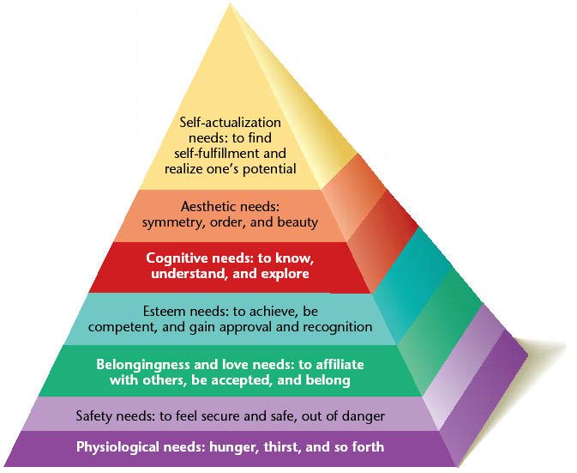
Maslow’s Hierarchy of Needs

Slide 7

Social Toxicity
HOMOPHOBIA
VIOLENCE
SEXUAL EXPLOITATION
Social factors that poison youths’ well-being and healthy development
HEALTH THREATS
SEXISM
DISRUPTED FAMILY RELATIONSHIPS
POVERTY
RACISM
LACK OF BENEVOLENT ADULT AUTHORITY

Slide 8

Inequity and Adolescence
Outcomes for Black, Latinx, and LGBTQ+ Youth, and Youth with Income Below Poverty Line
Lower Rates of High School & College Graduation
Health Disparities (pregnancy, STI, HIV, substance abuse)
Higher Rates of Detention, Foster Care Placement
National Academies of Sciences, Engineering, and Medicine. (2019). The Promise of Adolescence.

Slide 9
Supportive Research
Prevention Research
What predicts and prevents poor health outcomes?
Resiliency Research
What explains success despite the odds?
Youth Development Research
What predicts and promotes thriving?

Slide 10
Emerging Science of Learning and Development (SOLD)
Malleability
Experience dependent growth
Context
Brain Development
Pamela Cantor et al. 2018

Slide 11
Defining Positive Youth Development
A philosophy or approach that guides communities in the way they organize programs, supports and opportunities so that young people can develop to their full potential.
Focus on building positive outcomes
Youth voice and engagement
Long-term involvement/Developmentally appropriate
Universal/Inclusive
Community-based/Collaborative

Slide 12
Paradigm Shift
Traditional Youth Services
Positive Youth Development
Fixing Problems
Building on strengths
Reactive
Pro-active
Troubled Youth
All youth
Youth as Recipients
Youth as Participants/Resources
Programs
Relationships
Professional Work
Everyone’s Work
Adapted from Search Institute. 2001.
Old Attitudes/New Attitudes. Speaking of Developmental Assets.

Slide 13

Adolescent Development
What is going on in adolescence?
  Physically/sexually
  Cognitively
  Socially and emotionally
  Morally
What are some major tasks and events?

Slide 14

Tasks of Adolescence
Adjust to maturing
bodies and feelings
Develop/apply abstract
thinking skills
Develop/apply more
complex perspective
taking
Renegotiate
relationship with
adults
Develop/apply new coping skills
Take on increasingly
mature roles and
responsibilities
Identify moral
standards, values, and
beliefs
Develop identity
(different aspects)
Form friendships that
are close and supportive
Understand/express more
complex emotional experiences

Slide 15
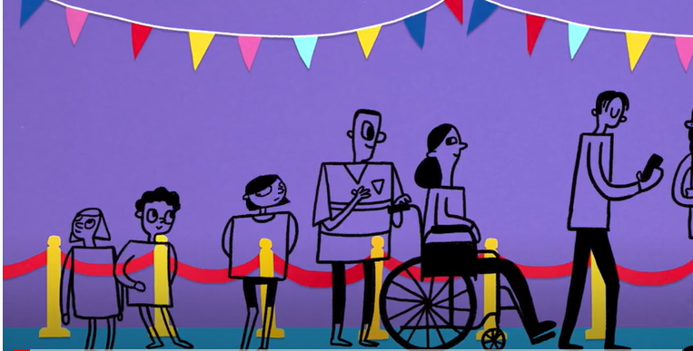
Adolescent Brain Development
https://www.youtube.com/watch?v=dISmdb5zfiQ

Slide 16

Theme:
Risk Taking
Do Something
www.dosomething.org
What Kids Can Do (WKCD)
www.whatkidscando.org/specialcollections/service_learning/index.html
ACT for Youth Toolkit: Risk Taking
http://www.actforyouth.net/adolescence/toolkit/risk.cfm

Slide 17

Theme: Identity Formation
Self-identity is how you
see yourself
Social identity is how
others see you.
A Process of Exploration and Commitment
Resource: http://www.actforyouth.net/adolescence/identity.cfm

Slide 18

Multiple Social Identities
Youngest of 4 kids
3 older brothers
Female
Lebanese
Guitar player
Middle class
College-bound

Slide 19
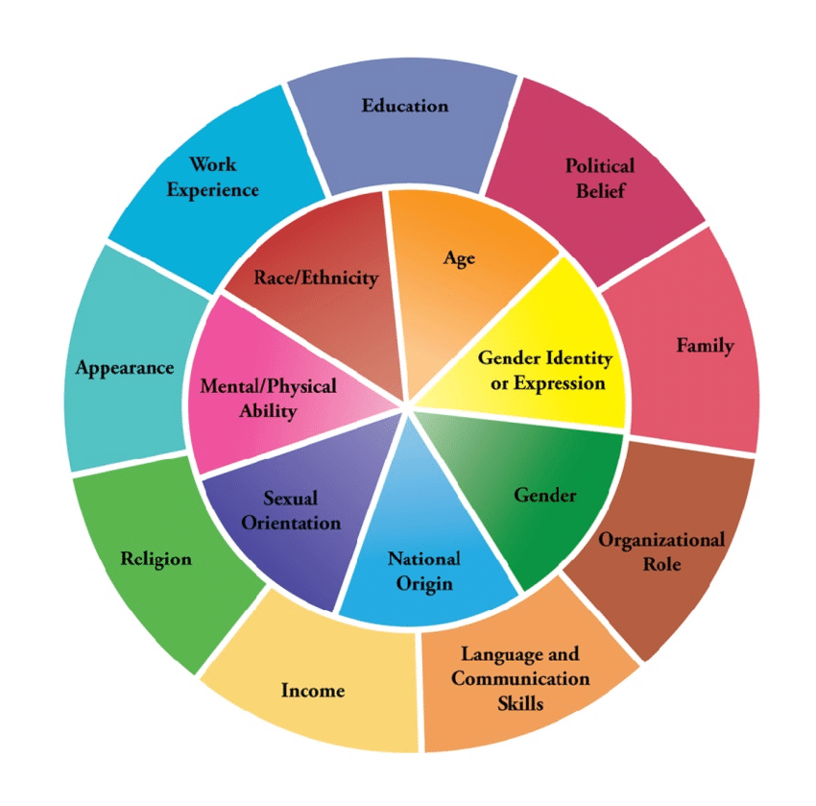
Multiple Social Identities
Adolescent population is increasingly diverse
LGBTQ Youth come out earlier; identities continue to evolve
National Academies of Sciences, Engineering, and Medicine. (2019). The Promise of Adolescence
Diversity Wheel as used at Johns Hopkins University

Slide 20

Sense of Self
A cohesive, congruent sense of self is linked to:
Self-esteem
Goal-setting
Emotional well-being
How can you support young people in their exploration of identity?

Slide 21
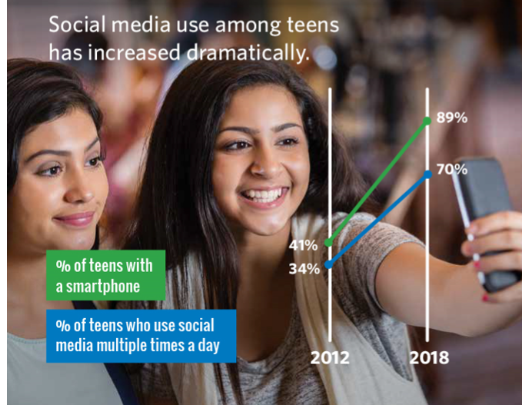
Theme: The New Digital World
The average 8- to 12-year-old American spent 4 hours and 44 minutes looking at screens each day in 2019
American teens, ages 13 to 18, used entertainment screen media for an average of seven hours and 22 minutes each day in 2019
https://www.commonsensemedia.org/social-media-social-life-infographic

Slide 22

What is the Impact?
Research ambiguous
  Youth with low social and emotional stability more likely to experience negative impact
Changes in:
  Connection
  Focus
  Rest
  Christine Carter, 2020

Slide 23
2. Positive Youth Outcomes

Slide 24

6 Cs
Confidence
Competence
Caring
Character
Connection
Contribution

Slide 25
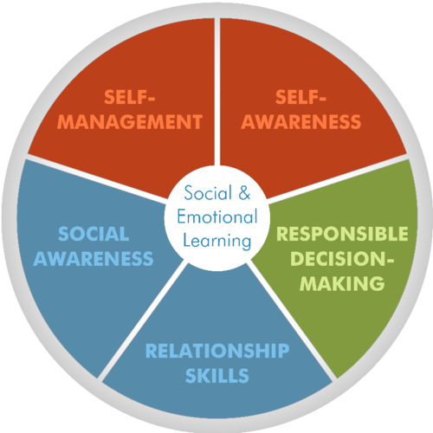
Embedded: SEL Core Competencies
Recognize one’s emotions,
values, strengths, and
limitations
Manage emotions
and behaviors
to achieve
one’s goals
Make ethical,
constructive choices
about personal and
social behavior
Show
understanding
and empathy for
others
Form positive relationships, work
in teams, deal effectively with conflict
www.casel.org

Slide 26

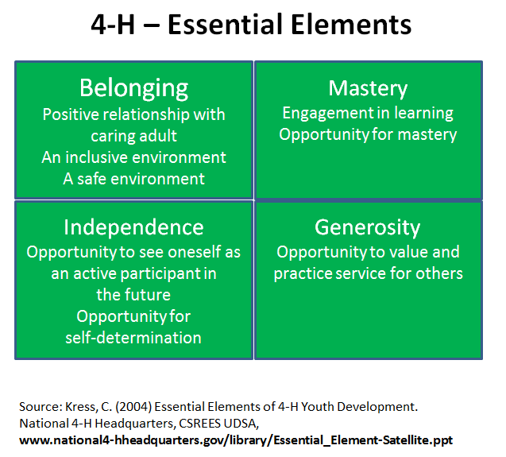

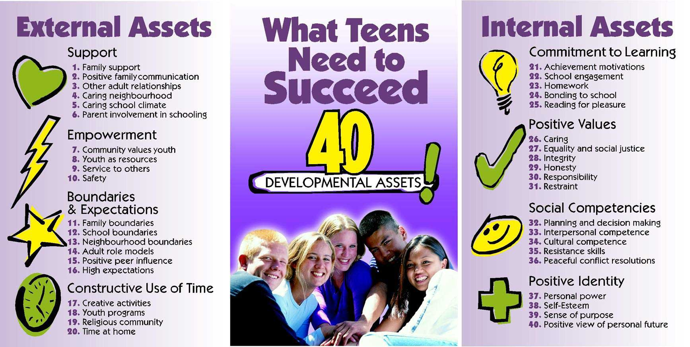
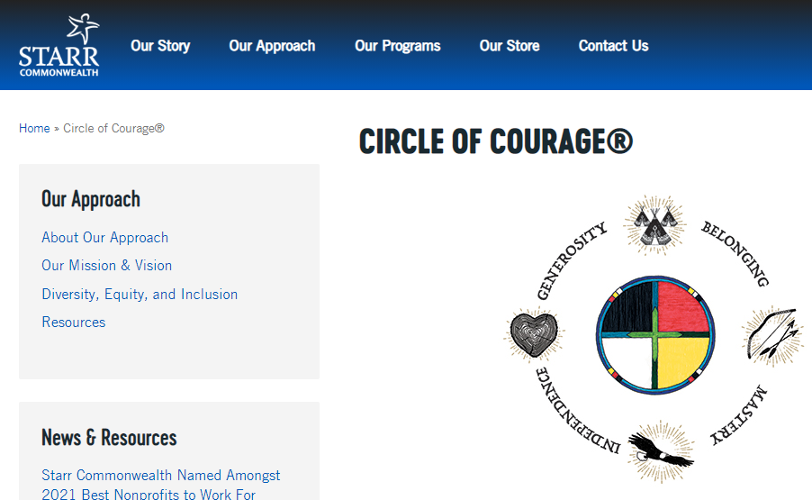
Other Outcome Models

Slide 27
Services – Opportunities – Supports
Provided to or for youth
Intended to enhance health, safety, performance,
and other
forms of
essential well being and physiological functioning
Conducted with youth
Relationships and resources to support emotional wellbeing; structure and guidance; access to info and resources
Supports
Services
Opportunities
Done by youth
Meaningful opportunities to practice and expand on what youth know and learn – either through work, service, or advanced learning

Slide 28
Family
Peers
Education
Safety
SERVICES
SUPPORTS
YOUTH
Community organizations
Businesses/ Employment
OPPORTUNITIES
Youth service organizations

Slide 29
Features of a Strength-Based Approach
People are active participants in the helping process (empowerment)
All people have strengths, often untapped or unrecognized
Strengths foster motivation for growth
Strengths are internal and environmental
Source: Saleebey, Dennis. 1992. The Strengths Perspective in Social Work Practice. Longman: White Plains, NY

Slide 30
Identify and Nurture Internal Strengths
Social Competence | Problem Solving | Autonomy | Sense of Purpose & Belief in the Future
-Responsiveness -Communication skills -Could recruit support -Empathy and caring -Compassion and forgiveness -Pro-social behavior | -Ability to plan -Flexibility -Insight -Critical thinking -Resourcefulness | -Positive Identity -Internal locus of control -Mastery and self efficacy -Adaptive distancing and resistance -Self-awareness and mindfulness -Humor | -Goal direction, achievement motivation and educational aspirations -Special interest, creativity, imagination -Optimism and hope -Faith, spirituality and sense of meaning
Bonnie Benard. 2004

Slide 31
Build on Internal Strengths
You believe that young people have strengths (attitude)
You identify personal strengths (you look beyond the problems)
You teach them that they have strengths (name them, show them how they are being used, suggest how they can use them in the future)
You give it time – you persist
Nan Henderson
Home - Resiliency in Action | Nan Henderson, M.S.W., Ph.D.

Slide 32

Sparks
"A spark is something that gives your life meaning and purpose. It’s an interest, a passion, or a gift.“
Dr. Peter Benson, Search Institute
http://www.search-institute.org/sparks
Video - https://www.youtube.com/watch?v=3YFw8oif_qU

Slide 33
Developmental Relationships
Developmental relationships are the active ingredients of effective interventions.
They are characterized by:
attachment/connection
reciprocity
progressive complexity
balance of power
Simple interactions are the building blocks; relationships emerge from accumulated interactions.
Li & Julian, 2012

Slide 34
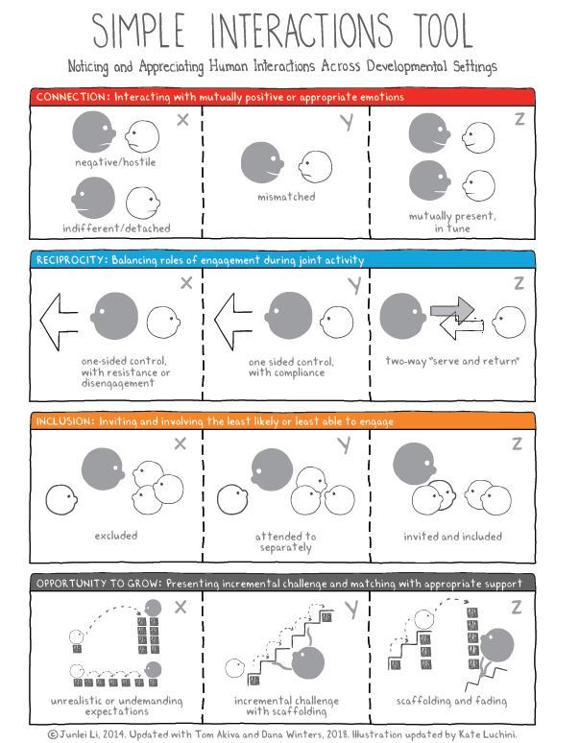
Simple Interactions Tool
https://www.simpleinteractions.org/

Slide 35
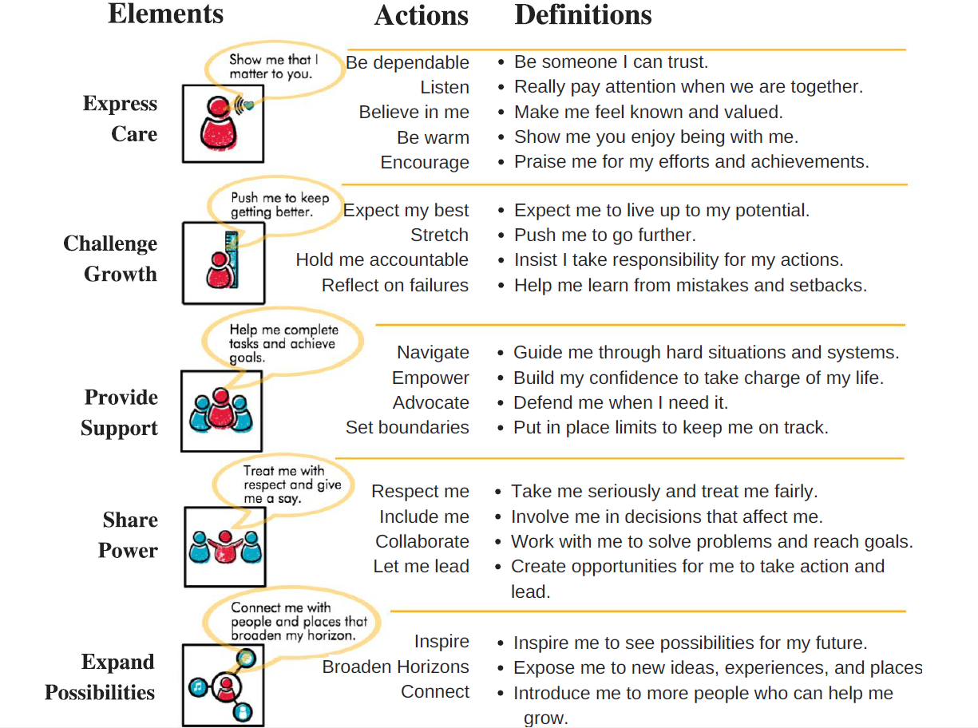
Developmental Relationship Framework
Search Institute. 2017.
Relationships First

Slide 36
Building Developmental Relationships
Sparks: What are your talents and passions?
Strengths: What are your abilities and values?
Struggles: What keeps you up at night?
Supports: People and places where you can be yourself?
4Ss interview: https://www.search-institute.org/wp-content/uploads/2019/08/4-Ss-Interview-download.pdf
Kent Pekel’s Ted Talk: https://www.ted.com/talks/kent_pekel_getting_relationships_right

Slide 37
3. Youth Voice & Engagement

Slide 38
Youth Engagement
… can be defined as involving youth in responsible, challenging action that meets genuine needs, with the opportunity for planning and/or decision-making affecting others…
there is mutuality in teaching and learning (between youth and adults) and … each group sees itself as a resource for the other and offers what it uniquely can provide.
National Commission on Resources for Youth, 1974

Slide 39

Examples of Youth Engagement
Youth in Governance
Youth Voice One Vision
(City of Rochester Mayor’s Youth Advisory Council)
https://www.cityofrochester.gov/yvov/
Forum for Youth Investment: Building Effective Youth Councils.
http://www.readyby21.org/resources/building-effective-youth-councils
Social Activism
Akiva, T., et al. (2017). Reasons youth engage in activism programs: Social justice or sanctuary? Journal of Applied Developmental Psychology 53. https://www.researchgate.net/publication/320107376_Reasons_youth_engage_in_activism_programs_Social_justice_or_sanctuary

Slide 40

Youth in Media/ Education
Video PSA: The Accidental Bully
https://www.youtube.com/watch?v=97de0hsC7xI&list=UUSS0AF2Eg9Bbbq4QpmjasMw
How Youth Learn: Ned’s GR8
  http://www.whatkidscando.org/featurestories/2013/01_how_youth_learn/index.html

Slide 41
Meaningful Roles for Young People
Leadership positions
INCREASED INFLUENCE ON ORGANIZATION
Shared Leadership
Voting members on boards
Committees (hiring, grant writing))
Youth Forum
Advocacy
Voice and Consultation
Advisory Group
Consultants
Focus groups/Surveys
Youth in media
Participation
Peer Education
Mentoring
Youth Theater
Youth as trainers/facilitators
Community Service Projects
MORE OPPORTUNITIES; MORE YOUNG PEOPLE CAN GET INVOLVED

Slide 42
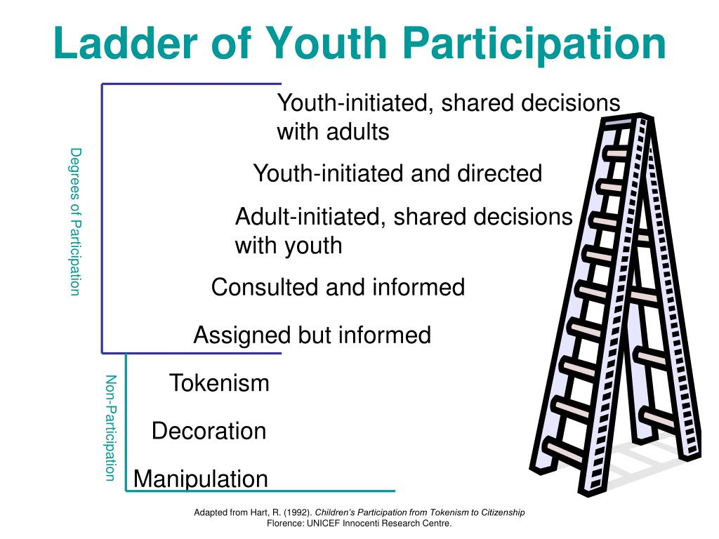
https://www.unicef-irc.org/publications/pdf/childrens_participation.pdf

Slide 43

Benefits for Youth
Civic Development (skills, attitudes, awareness)
Social/Emotional Development (belonging, efficacy)
Vocational Development (skills, social capital)
Notes:
43

Slide 44
Benefits for Adults, Organizations, and Communities
Professional Development (skills, confidence)
Social/Emotional Development (connectedness)
Organizations reflect & respond to youth concerns
Organizations are more appealing to potential funders
Public policies/programs are more effective & equitable
New coalitions emerge to address issues
Notes:
44

Slide 45

Obstacle: Adultism
…the behaviors and attitudes which flow from negative stereotypes adults hold about youth.
John Bell, 1995
http://nuatc.org/articles/pdf/understanding_adultism.pdf

Slide 46
Manifestations of Adultism
Dysfunctional Rescuing
Blaming the Victim
Avoidance of Contact
Denial of Distinctiveness of Youth Culture
Denial of the Political Significance of Adultism
Advancing Youth Development (AYD) Curriculum

Slide 47
Scenario 1
Two young people are planning to do a presentation about a recently completed community service project at the agency’s annual meeting. The day before the event the adult program leader sees that the young people are not that well prepared and decides to take over as the lead presenter.

Slide 48
Scenario 2
In a work readiness program a young person is repeatedly missing sessions and appointments (he relies on his parents for transportation). The program coordinator sees the young person as irresponsible and unreliable and decides to drop him from the program.

Slide 49
Scenario 3
An agency administrator uses new funding to start up an afterschool program for teenagers. He develops the program to best fit the structure of programming in his agency.
Trying to maximize space utilization he puts the new program into a room originally designed for a nursery school.

Slide 50
Scenario 4
The agency decides to have young people on their board of directors. One young person is selected and asked to be on the board. The youth is expected to attend every board meeting. The board meets once a month from 7-9PM in the agency’s main office downtown.

Slide 51
Scenario 5
A group of young people is planning a teen center. Two group members are charged with investigating zoning regulations and related city policies. They decide to go directly to city hall to do the research. The receptionist initially ignores them; finally she asks what they are doing here. Asking to meet with a staff person at the planning department, they are told that staff does not have time to meet with them.

Slide 52

Defeating Adultism
Self-Reflection
Deconstruct adultism

Slide 53

Youth-Adult Partnership Resource
Being Y-AP Savvy:
A Primer on Creating & Sustaining Youth-Adult Partnerships
http://actforyouth.net/resources/n/n_y-ap-savvy.pdf

Slide 54


Youth Adult Partnership Tools
Youth and Adult Leaders for Program Excellence (YALPE)
http://actforyouth.net/resources/n/n_yalpe-workbook.pdf
Youth-Adult Partnership RUBRIC
https://cerc.msu.edu/yaprubric

Slide 55
Preparing Youth (Resources)
Gardner Center, Stamford University. YELL http://jgc.stanford.edu/our_work/yell.html
Advocates for Youth. 2009. Building Effective Youth-Adult Partnerships https://advocatesforyouth.org/resources/fact-sheets/building-effective-youth-adult-partnerships/
Innovation Center for Community and Youth Development, National 4-H Council, National Network for Youth, Youth Leadership Institute. 2003. Youth-Adult Partnerships: A Training Manual. Youth-AdultPartnershipsTrainingManual.pdf (wisc.edu)
Adolescent Health Initiative: Creating and Sustaining a Thriving Youth Advisory Council https://www.umhs-adolescenthealth.org/wp-content/uploads/2017/02/manual-for-website.pdf

Slide 56
4. Youth Development Programming

Slide 57
Features of Positive Developmental Settings
Physical and Psychological Safety
Appropriate Structures
Supportive Relationships
Opportunities to Belong
Positive Social Norms
Support for Efficacy and Mattering
Opportunities for Skill Building
Integration of Family, School and Community Efforts
National Research Council (2002)

Slide 58
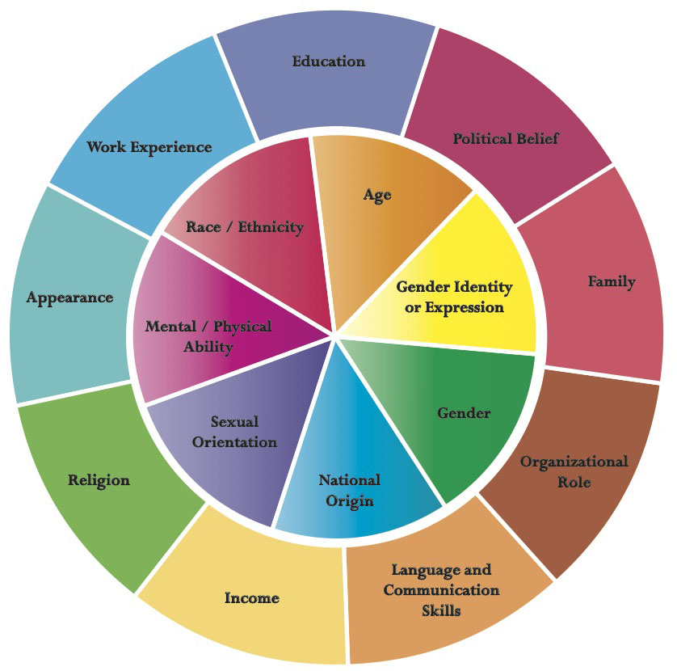
Adolescents increasingly diverse
Many youth experience trauma, discrimination and inequities
National Academies of Sciences, Engineering, and Medicine. (2019). The Promise of Adolescence.
Diversity Wheel as used at Johns Hopkins University

Slide 59
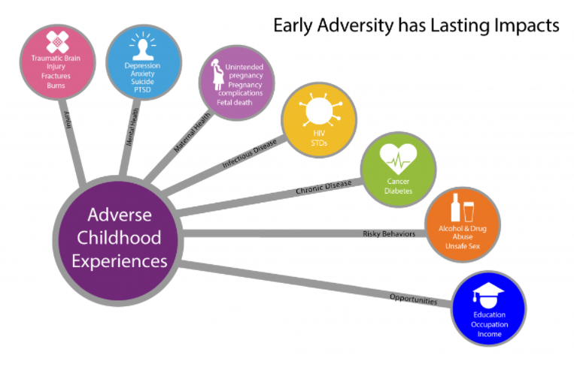
https://www.cdc.gov/violenceprevention/aces/about.html

Slide 60
Using a Trauma-Informed Approach
Guiding Principles
Safety
Trustworthiness
Choice
Consider Culture, History, Gender
Collaboration
Empowerment
SAMHSA 2014

Slide 61
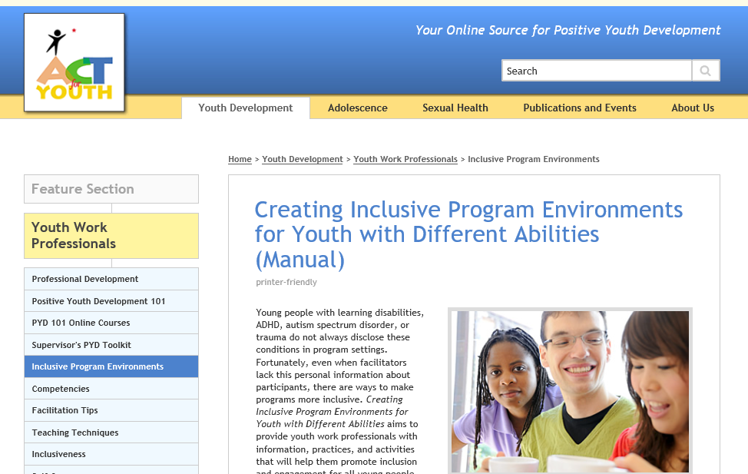
Resource
http://www.actforyouth.net/youth_development/professionals/inclusive-environments.cfm

Slide 62
Scaffolding – A Teaching Strategy
End Point
Vygotsky’s Zone of Proximal Development
Starting Point
Learning Zone

Slide 63
Scaffolding Process
Feedback
Explaining
Modeling

Slide 64
Scaffolding Process
Feedback
Prompting
Youth teaching steps

Slide 65
Example: Life Skills – Doing Laundry
Objective
Steps
Gather dirty clothes
Choose detergent
Choose setting
Do laundry
Sort clothes
Explain types of clothing (temp)
Explain types
Explain cycles
Check labels

Slide 66
Key Elements of Scaffolding
Break down complex skills into smaller units/steps
Assess the young person’s skill level
Work closely with the young person, providing guided support
Ensure a positive ending

Slide 67
Feedback
Feedback is specific and descriptive, not interpretive or judgmental
Corrective Feedback
Describe the behavior and offer an alternative action or elicit an alternative from the child, asking what she or he could have done differently.
Positive Feedback
Describe the behavior emphasizing the child’s strengths, skills, and the outcome.

Slide 68
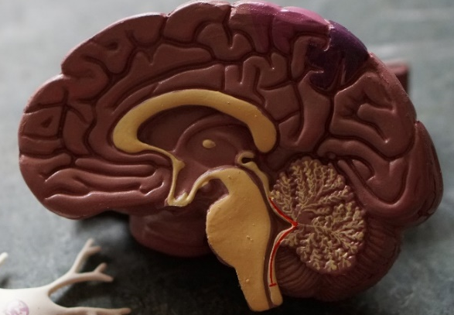

What to Praise?
Intelligence?
Chooses easier tasks
Gives up faster with challenging tasks
Effort?
Chooses difficult tasks
Handles failure
Video: Carol Dweck – A Study on Praise and Mindsets
https://www.youtube.com/watch?v=NWv1VdDeoRY

Slide 69
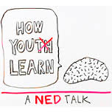
Active Learning
WKCD: How Young
People Learn
http://www.whatkidscando.org/featurestories/2013/01_how_youth_learn/

Slide 70

Helpful Strategies and Tools
Involve youth in planning activities and programming
Hands-on learning/experiential learning
Focus on the process: reflection and critical thinking
Use multiple intelligences
Collaborative learning

Slide 71
5. Youth Worker Competencies

Slide 72
Competencies: Content Areas
Curriculum
- Professionalism
Connecting with Families
Health, Safety, and Nutrition
Child & Adolescent Development
Cross‐cultural Competence
Guidance
Professional Development
Program Management
Connecting with Communities
Environment
To be added:
Digital learning
Trauma-informed youth work

Slide 73
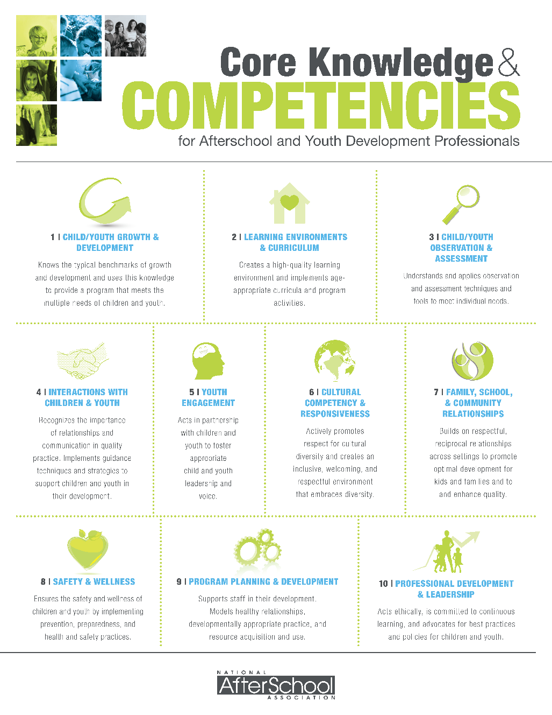
Frameworks of Core Competencies
Youth Work Core Competencies Review: http://www.niost.org/pdf/Core_Competencies_Review_October_2009.pdf
Core Competencies for Youth Workers: https://networkforyouthsuccess.org/wp-content/uploads/2014/08/DYCD_Core-Competencies-for-Youth-Workers.pdf
Core Knowledge and Competencies:
https://naaweb.org/images/Core-Knowledge-and-Competencies-web.pdf

Slide 74
Ongoing Professional Development
NYS Networks
PASE https://pasesetter.org/
NYS Network for Youth Success https://networkforyouthsuccess.org/
Association of NYS Youth Bureaus https://anysyb.net/
NYS 4-H https://nys4-h.org/
Where do you go?
  In-house?
  In the community?
  Online?

Slide 75

Implicit Bias
https://outsmartinghumanminds.org/module/the-universe-inside/

Slide 76
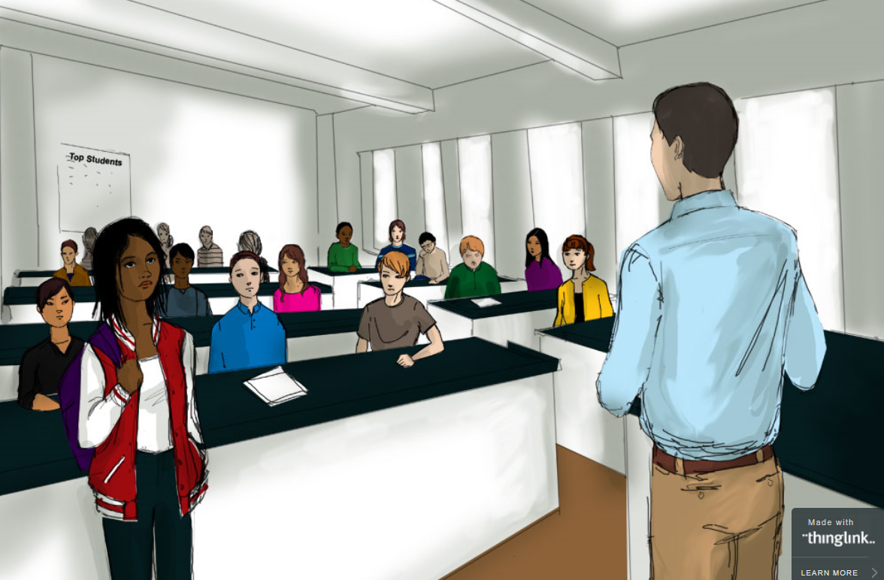
Impact of biases?
Microaggressions
How else can our biases surface?
https://www.edweek.org/ew/section/multimedia/illustration-microaggressions-in-the-classroom.html

Slide 77
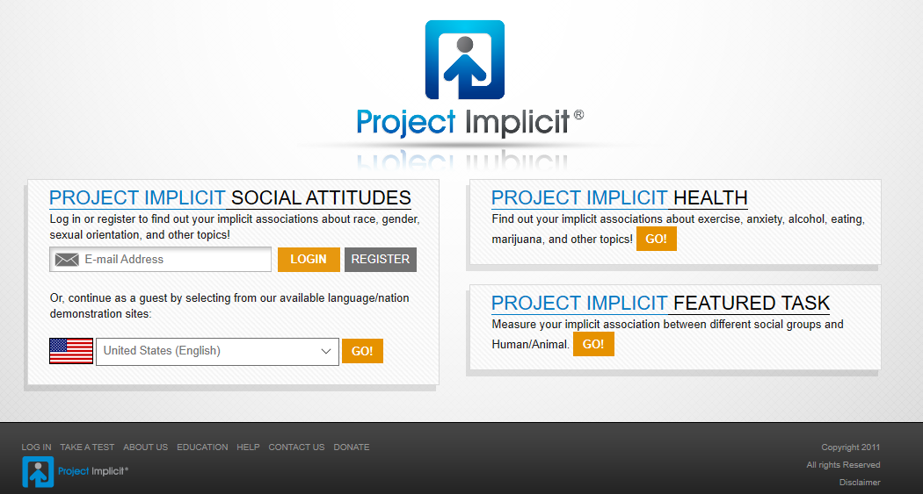
Attitude Check
https://implicit.harvard.edu/implicit/

Slide 78
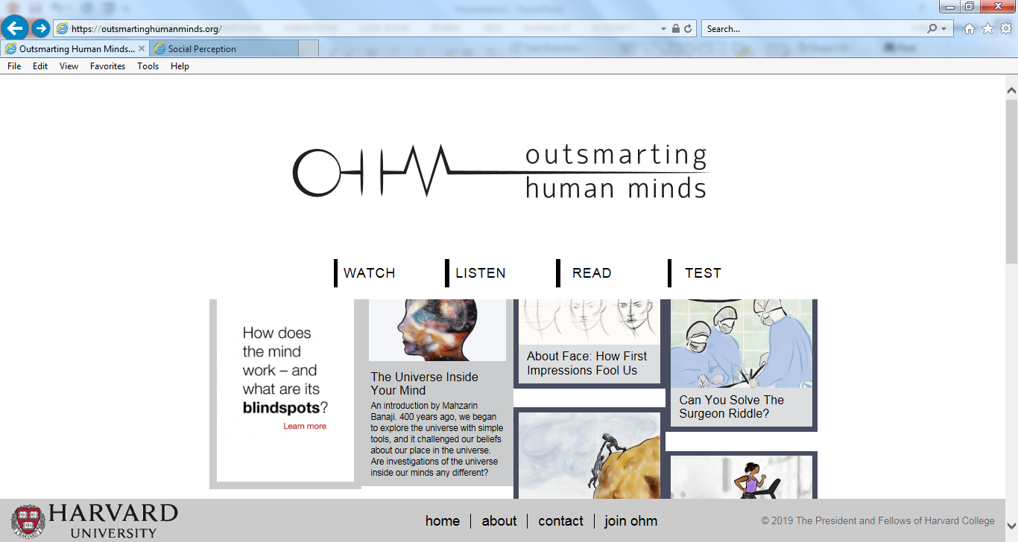
https://outsmartinghumanminds.org/

Slide 79

Central Tension in Youth Work
Youth workers are directed by professional norms, program and organizational objectives and expectations
Youth workers engage with young people in an informal, personal manner (building rapport)

Slide 80

Research: Dilemmas of Practice
The Youth Development Experience
113 youth – 661 interviews
25 program leaders – 125 interviews
167 site observations
Resulting in 250 dilemmas
Reed Larson, University of Illinois
www.youthdev.illinois.edu/

Slide 81
Process: Problem Solving Dilemmas
What are the concerns? Contributing factors?
Which are the most pressing ones? And why?
What are possible responses? (Brainstorm)
Of the possible responses which response would you choose? And why?
Any larger takeaway messages?

Slide 82

Moving Forward
Competencies are important
Use community resources
Set boundaries
Experience matters
Discuss and learn from dilemmas

Slide 83
Wrapping Up
I feel…
I learned…
I never knew…
I now understand…
I wish…
I’m glad that…
I appreciate

Slide 84


